Slide 1

BOOK RECOMMENDATION SYSTEM
Pooja Songadkar

Slide 2
OBJECTIVE
GOAL
Design book recommendation system by several methods and explore the strengths and weaknesses of each method
RESEARCH QUESTION
How can we calculate the similarity between books based on their content? How can we apply it to a recommendation system?
How can we predict the rating that a user will give to books that they haven't read? How can we apply it to a recommendation system?
What are the strengths and weakness of each method? How to overcome that weakness?

Slide 3



TYPES OF RECOMMENDATION SYSTEM
Content Based Filtering Collaborative Filtering
liked by user
read by both users
similar books
similar users
Recommended
to user
Recommended
to him
liked by her
Measure similarity between books Example: cosine similarity
Process: Text Vector using TfidfVectorizer
Memory-based:
Predict ratings by learning user’s pattern of giving ratings. Example: KNN
Model-based:
Predict ratings by learning user latent factor and item latent factor. Example: SVD, SVD++

Slide 4
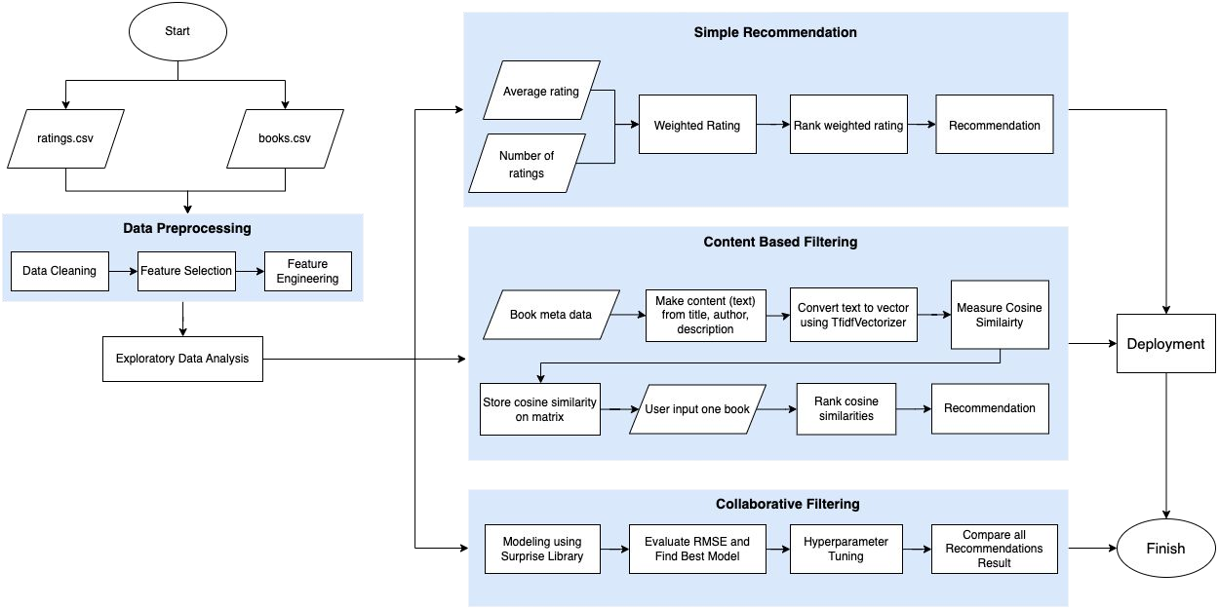
SYSTEM FLOWCHART

Slide 5
DATA PREPROCESSING
MISSING VALUE HANDLING
FEATURE SELECTION
Column Name | percent_missing
isbn | 7.00
original_title | 5.85
isbn13 | 5.85
pages | 0.73
description | 0.57
original_publication_year | 0.21
publishDate | 0.08
30 features
10 features
ratings.csv |  | book_cleaned.csv
book_id |  | book_id
user_id |  | title
rating |  | authors
FEATURE ENGINEERING Remove unnecessary character in authors, description and genre Lowercase description Change year datatype from string to integer |  | year
 |  | pages
 |  | description
 |  | genres
 |  | average_rating
 |  | ratings_count
 |  | books_count
Impute original_publication_year using publishDate, then drop publishDate
Impute pages with median
Impute description with book’s title
Drop the rest

Slide 6

04
Exploratory Data Analysis

Slide 7
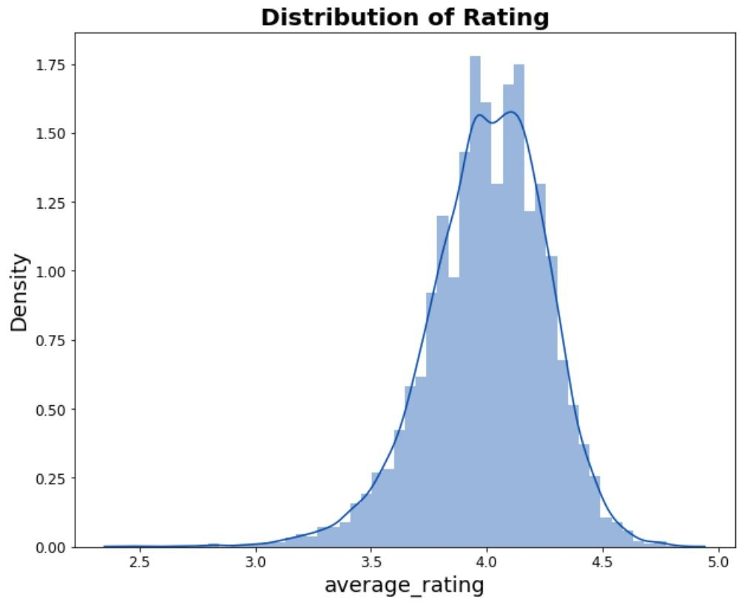
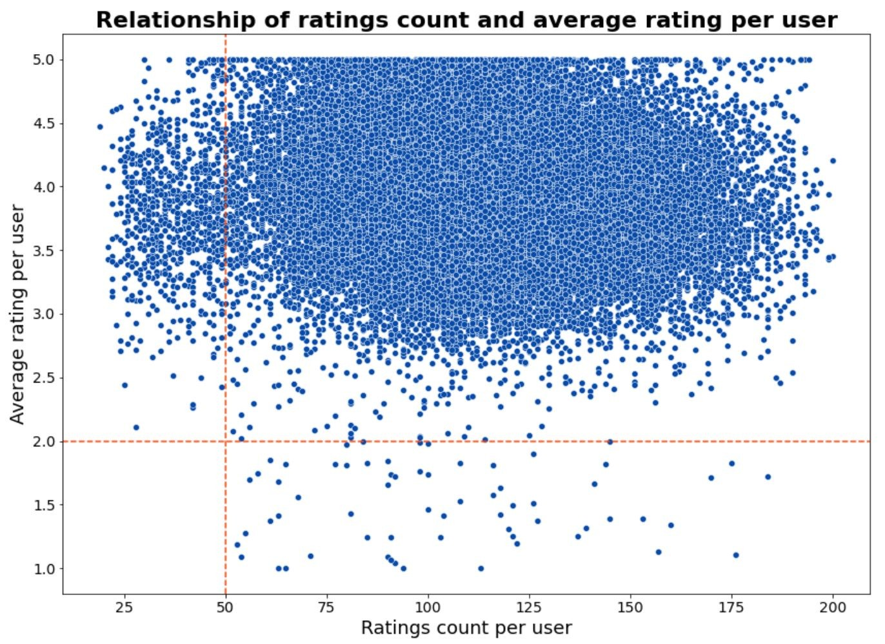
How is the distribution of ratings?
Does the number of reviews affect ratings?
Since this is the list of 10,000 popular books, the majority of the books have an average value of 4.02.
People who rate < 50 books tend to give higher ratings. People start to give lower rating if they read more books.
This could be a result of an inappropriate book recommendation system, so that people end up reading books they don't like.

Slide 8
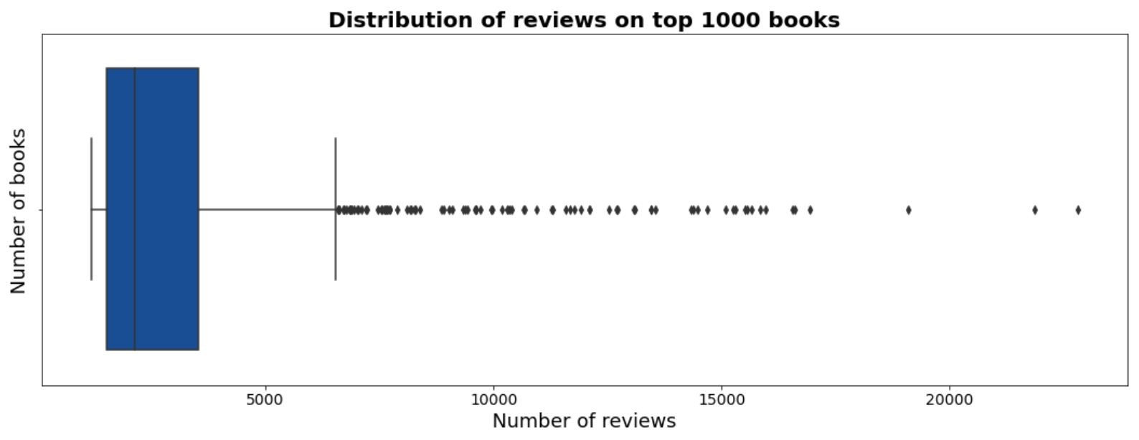
How many ratings does a book usually get?
At most: 22,806 ratings At least: 8 ratings Average: 248 ratings
The distribution of reviews on books is positively skewed. There are more books that has less ratings.

Slide 9
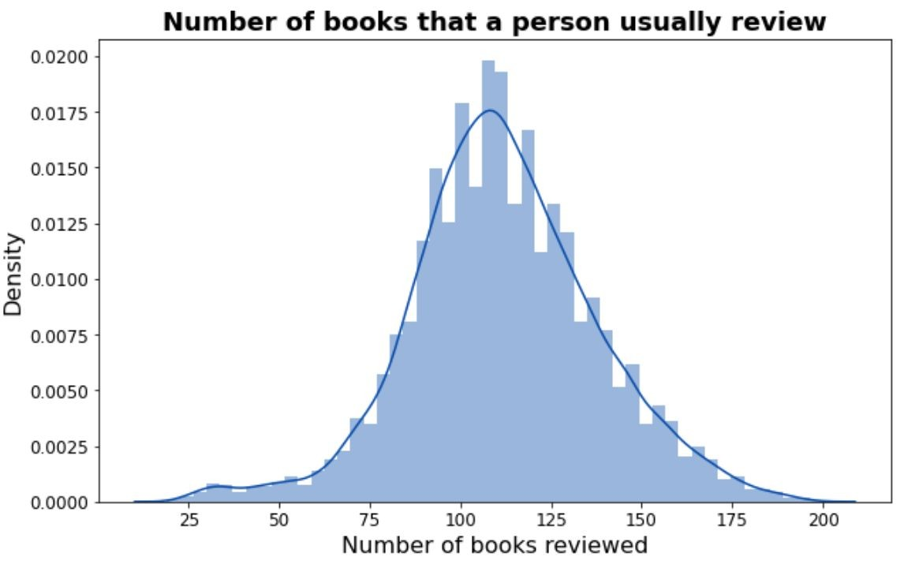
How many ratings does a user usually give?
At most: Rated 200 books At least: Rated 19 books. Average: Rated 111 books.
From 10,000 books in our dataset, even the user with the highest number of reviews managed to give a rating to only 2% of all of the books.
Data in user is very sparse, so it will be better to use item-based collaborative ﬁltering.

Slide 10
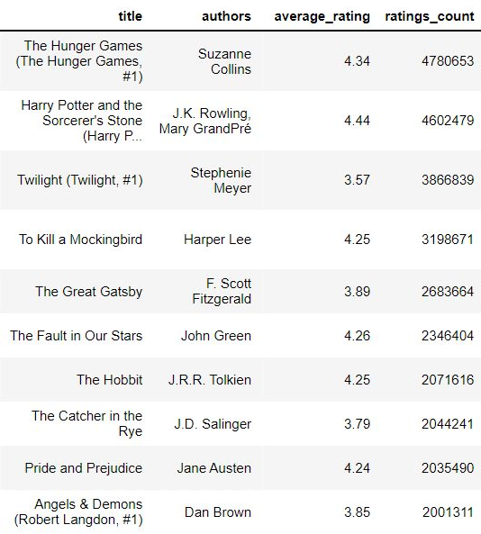
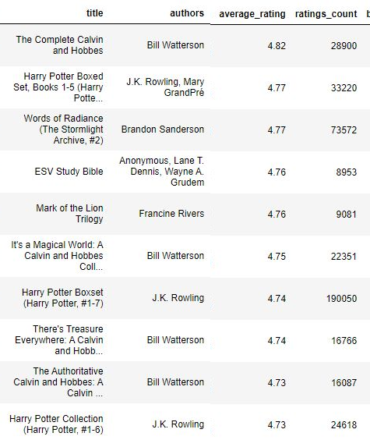
RANK THE BOOKS
Books (ratings_count)
Books (average_rating)
higher rank
lower rank
There are several popular books that have a lower rating
Books with a high rating sometimes have a lower number of reviews
We need to make a weighted score that combines average_rating and rating_count

Slide 11

Modelling
Simple Recommender
Content Based Recommendation
Collaborative Filtering Recommendation

Slide 12
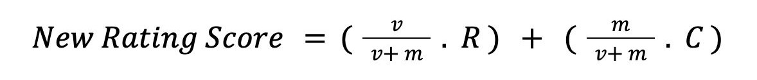
1. SIMPLE RECOMMENDER
This is a non-personalized recommender.
One of the easiest way to give recommendation is to rank the book based on rating (average_rating ) or ratings_count .
However, as we mentioned in EDA, we need to make a weighted rating of
average_rating and rating_count .
New Rating Score formula used in Internet Movie Database (IMDb)
where:
v = number of ratings (ratings_count)
m = minimum ratings_count required to be recommended R = average of ratings (average_rating)
C = the mean ratings for all books

Slide 13
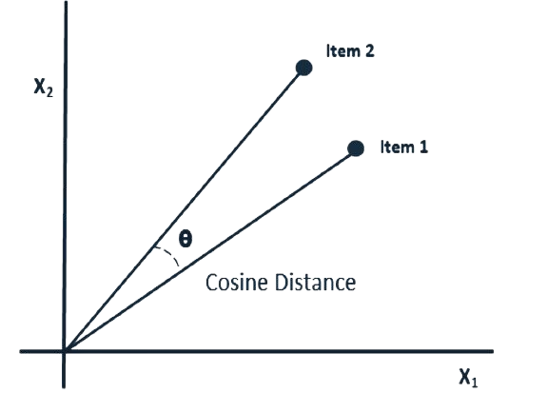
2. CONTENT BASED FILTERING
This approach makes recommendations to users based on the features or characteristics of the books. Using item metadata, the computer will assess how similar the books are to one another and then recommend the books that are most like the one the user loved. One of the way is using cosine similarity.
Flow Content Based Filtering
1 2
3
4
5
6
Collect feature (title, author, description and genre) as a content
Convert content using TfidfVectorizer
Measure cosine similarity
for all books
Input favorite book
Rank the cosine similarity of the books based on input
Recommend books

Slide 14
3. COLLABORATIVE FILTERING
This approach recommends books to users based on their prior reading habits and the preferences of other users.
User item interaction matrix User matrix
Item matrix
1 |  | 3 | 5 |  | 5
 |  | 5 |  | 4 |  | 5
5 | 2 |  | 4 |  | ? | 2
3 |  | 4 |  | 5
5 | 2 |  | 4 |  | 3 | 1
≈
K
user
x
user
(approximately equal)
(multiply))
item
item
K
Flow Collaborative Filtering
1 2
3
4
5
6
Split train and test data 70:30
Fit to model Normal Predictor, KNN,SVD,andSVD++
Compare RMSE, memory use and model ﬁt duration
Pick and tune best model
Predict rating in full data
Recommend books for certain user

Slide 15

Result and Evaluation
Evaluation in Collaborative Filtering Recommender

Slide 16
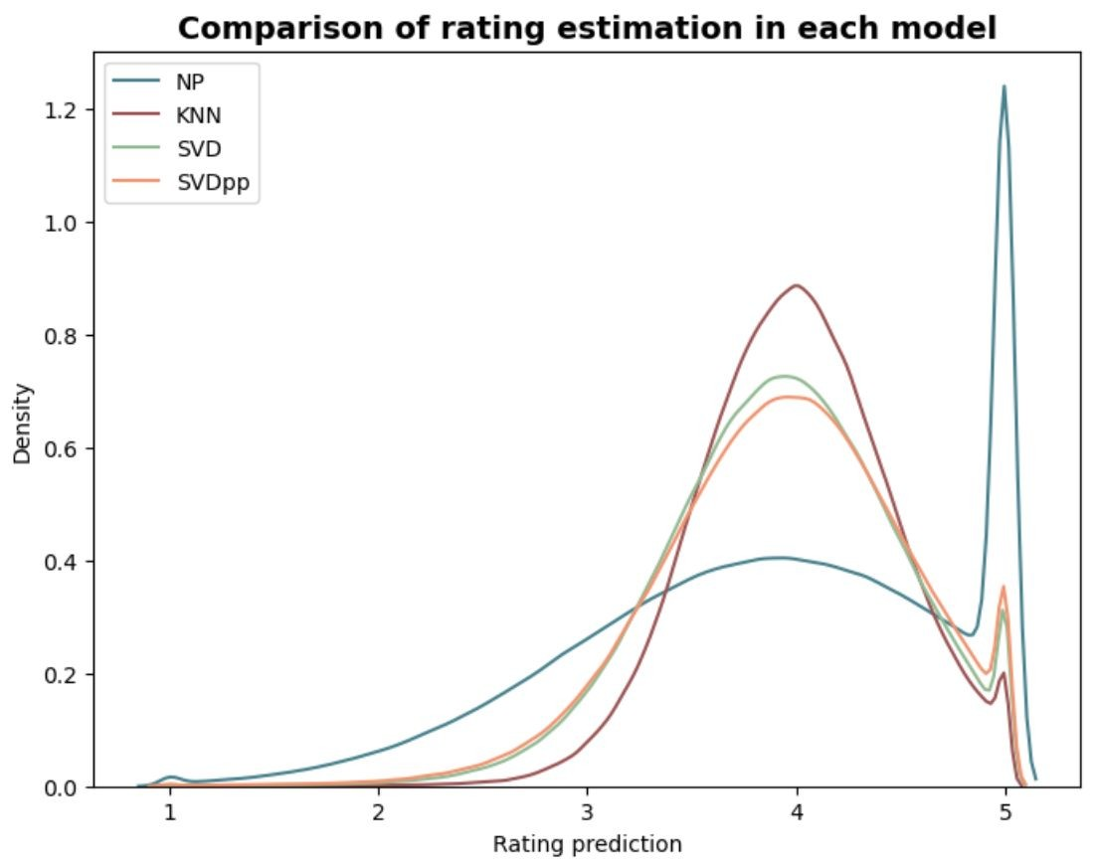
Base Model Comparison
Model | RMSE* Train | RMSE* Test | Time | Estimated Memory Use in AWS
Normal Predictor (NP) | 1.3233 | 1.3236 | 3m 40s | 8.7 GB
KNN | 0.8001 | 0.8851 | 24m 45s | 16+ GB
SVD | 0.6441 | 0.8386 | 7m 5s | 8.8 GB
SVD++ | 0.7085 | 0.8238 | 1h 9m 50s | 8.4 GB
* RMSE based on rating (rating 1-5)
Although SVD++ shows lower RMSE results, it takes a very long time to do the calculations. If we look at the rating predictions, the distribution of ratings on SVD and SVD++ is not much diﬀerent.
NP predicts higher ratings more often
KNN predictions are concentrated around the mean
SVD and SVD++ are more distributed

Slide 17
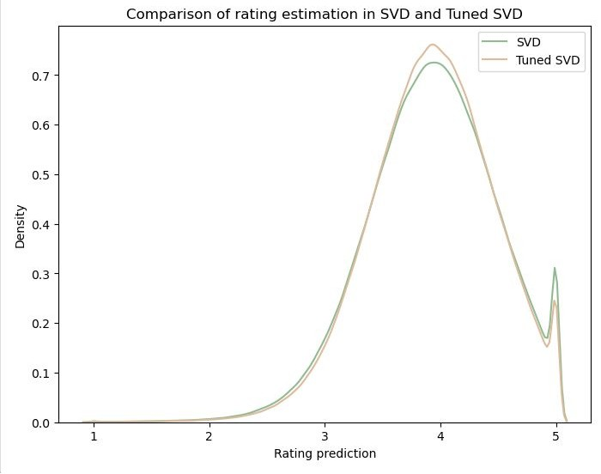
SVD with Hyperparameter Tuning
Parameters:
n_epochs: the number of iterations of the SGD procedure
lr_all: the learning rate for all parameters
reg_all: the regularization term for all parameters
Model | Parameters |  |  | RMSE
 | n_epochs | lr_all | reg_all
Base SVD | 20 | 0.005 | 0.02 | 0.8386
Tune SVD | 30 | 0.005 | 0.04 | 0.827
Tuned model has better RMSE than base model
Rating prediction around the
mean is higher in tuned SVD

Slide 18
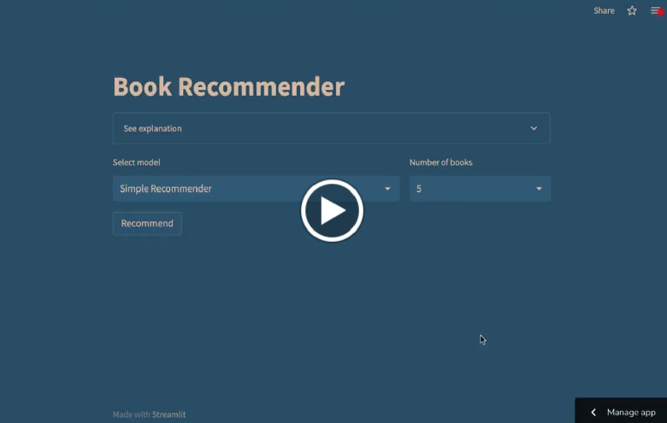
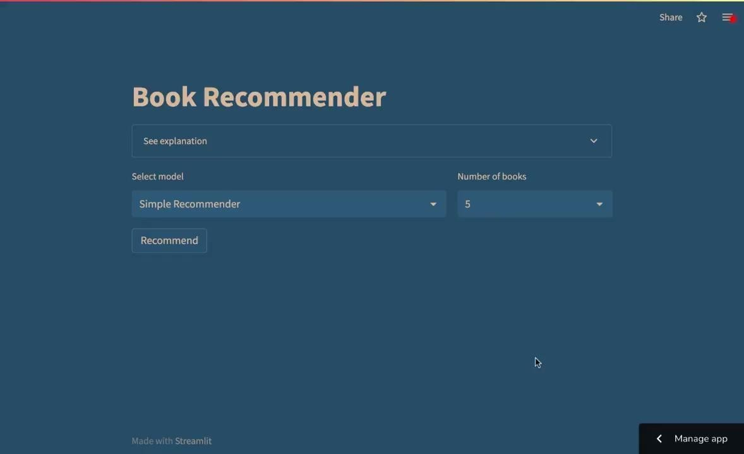
Flow when using the recommendation system
DEPLOYMENT

Slide 19
SAMPLE RESULT USING SIMPLE RECOMMENDER
for all users (general recommendation based on weighted score)
Book Title | average_rating | rating_count | weighted_rating
Harry Potter and the Deathly Hallows (Harry Potter #7) | 4.61 | 1746574 | 4.56
Harry Potter and the Half-Blood Prince (Harry Potter #2) | 4.54 | 1678823 | 4.49
Harry Potter and the Prisoner of Azkaban (Harry Potter #3) | 4.53 | 1832823 | 4.49
Harry Potter and the Goblet of Fire (Harry Potter #4) | 4.53 | 1753043 | 4.48
Harry Potter and the Sorcerer's Stone (Harry Potter #1) | 4.44 | 4602479 | 4.43

Slide 20
SAMPLE RESULT USING CONTENT BASED FILTERING
for user that input books ‘1984’:
Title | Authors | Notes
Animal Farm / 1984 | George Orwell | same author, same genre (ﬁction, science ﬁction, classics)
We | Yevgeny Zamyatin | same genre (ﬁction, science ﬁction, classics)
Homage to Catalonia | George Orwell | same author
1Ǫ84 #1-2 (1Ǫ84, #1-2) | Haruki Murakami | similar title, same genre(ﬁction, science ﬁction), has word 1984 in description
The Far Side Gallery | Gary Larson | same genre(ﬁction), has word 1984 in description
Has a high rating but not popular
Is popular and has a high rating
Is popular but has a lower rating

Slide 21
SAMPLE RESULT USING COLLABORATIVE FILTERING
for user 12874 (user that gave most ratings)
Normal Predictor | KNN | SVD | SVD++ | SVD Tuned
The Hunger Games (The Hunger Games, #1) | The Help | The Help | The Help | The Help
The Fault in Our Stars | The Girl Who Played with Fire (Millennium, #2) | Ready Player One | World Without End (The Kingsbridge Series, #2) | The Nightingale
Lord of the Flies | Tuesdays with Morrie | Wonder | I Am Pilgrim (Pilgrim, #1) | Harry Potter Collection (Harry Potter, #1-6)
Life of Pi | The Five People You Meet in Heaven | Go Ask Alice | The Holy Bible: English Standard Version | The Indispensable Calvin and Hobbes
Water for Elephants | The Girl Who Kicked the Hornet's Nest (Millennium, #3) | Morning Star (Red Rising, #3) | ﺔﯾروطﻧطﻟا | The Divan
Has a high rating but not popular
Is popular and has a high rating
Is popular but has a lower rating

Slide 22
Strength and Weakness of Each Model
METHOD | PROS | CONS
Simple Recommender | suitable for new user relatively easy | does not provide user-speciﬁc recommendations result is obvious
Content Based Filtering | personalized, recommend based on user interest doesn’t need data about other users | cannot provide recommendations across genres (not diverse) result rely on the what is written in the content
Collaborative Filtering | more personalized more diverse | cold-start problem when there is new user/new item need data about other users

Slide 23

Conclusion and Recommendation

Slide 24
Conclusion and Recommendation
We need to understand when to use each model.
When we want to recommend a completly new user, we can use Simple Recommender.
If the user want personalized recommendation, they can provide one book they liked.
By applying a Content Based Filtering, instead of having to rate 30 books to start the recommendation engine, users can just pick only one book for Goodreads to provide good recommendations. We must pay attention to what content is chosen, whether only the author, the description etc.
When they want even more diverse recommendation, we can use Collaborative Filtering.
Here, we need other users data so that we can make the recommendation.
For this method, I think SVD is suitable for making a recommendation system in Goodreads because of its lower RMSE, faster calculation and lower memory requirement unlike KNN. I think the RMSE value of 0.8 is still quite reasonable for a Goodreads rating.
Here, we use RMSE as evaluation metrics. In addition to using metrics, recommendations must also be evaluated by the user, in particular whether the recommendations suit their taste or not.
Amazon Kindle can take advantage of the connection to Goodreads by collecting data on how many books were bought after being recommended on Goodreads.

